Slide 1

G2M insight for Cab Investment firm
Virtual Internship
March – May 2025

Slide 2
Background –G2M(cab industry) case study
XYZ Private Equity Firm is evaluating investment opportunities in the rapidly growing U.S. cab industry. With multiple key players in the market, identifying the right company for investment is crucial.
Objective:
Provide actionable insights to help XYZ firm make an informed investment decision by analyzing industry trends and company performance.
Analysis Approach:
The analysis is structured into four key areas: 1️⃣ Data Understanding – Exploring market trends and key performance indicators. 2️⃣ Profit & Ride Forecasting – Predicting future profitability and ride demand for each cab type. 3️⃣ Company Profitability Analysis – Identifying the most profitable cab service provider. 4️⃣ Investment Recommendations – Strategic insights to guide investment decisions.

Slide 3
Dataset Understanding

Slide 4
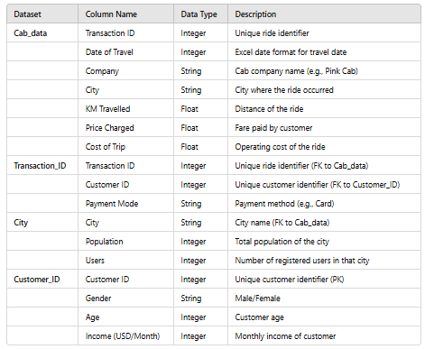
Data Exploration
Understand the Field Names and Data Types
I have four datasets:
Cab_data.csv
Contains details of cab rides, including trip info, price, and cost.
Transaction_ID.csv
Links transactions with customer IDs and payment modes.
City.csv
Provides city-level data on population and users.
Customer_ID.csv
Contains customer demographics (age, gender, income).
Dfs

Slide 5
Relationships Across the File
)
Understand the Field Names and Data Types
Cab_data (Transaction ID ) Transaction_ID (Transaction ID
Links each cab ride to a specific customer and payment mode.
Transaction_ID (Customer ID) Customer_ID (Customer ID)
Links each ride to a customer’s demographic details.
Cab_data (City) City (City)
Connects cab rides with city-level data like population and user base.

Slide 6
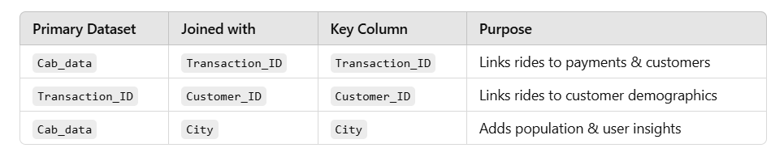
Create Master Data & Explain Relationships
)
Understand the Field Names and Data Types
The final master dataset contains:
Ride details (company, distance, price, cost)
Customer details (age, gender, income)
City details (population, users)
This allows us to analyze profitability, customer segments, and city-wise trends.
Cab_Data.csv
Customer_ID.csv
Transaction_ID.csv
City.csv
merged_data

Slide 7
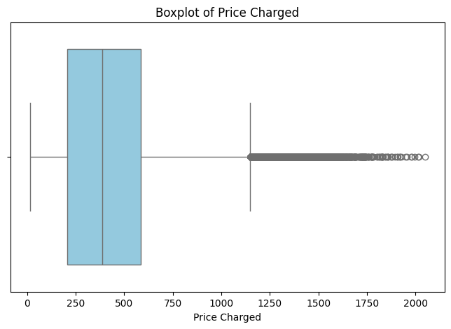
Data Exploration
26 Features( including 12 derived features)
Timeframe of the data: 2016-01-02 to 2018-12-31
Total data points :359392
Findings and Assumptions:
There is no duplicates found in the merge dataset
I found it, there is an outlier present in the Price Changed column,
and the number of the outlier is 5969 which is around 1.65 percent of the
total data so, instead of dropping this information,
I will retain it due to lack of journey duration.

Slide 8
Data Exploration
Profit of rides are calculated keeping other factors constant and only
Price_Charged and Cost_of_Trip features used to calculate profit.
Users feature of city dataset is treated as number of cab users in the city.
we have assumed that this can be other cab users as well(including Yellow and
Pink cab)

Slide 9
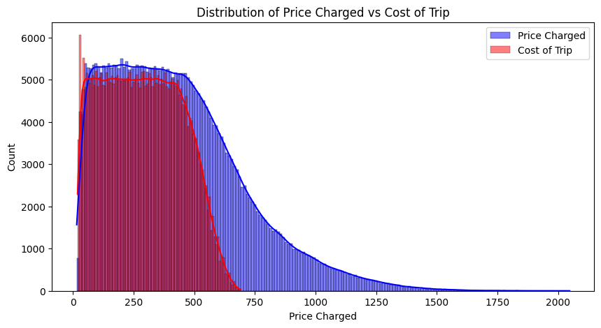
Profit Analysis
Profit Analysis
Distribution of trip cost vs price charged
Both distributions are right-skewed, meaning most trips have lower prices/costs, but there are a few high-value trips. Overlap in Lower Range.
The Cost of Trip (red) and Price Charged (blue) overlap significantly in the lower price range (0-500). This suggests that for most trips, the cost and price charged are closely aligned. Higher Price Charged Beyond Cost.
Beyond 500, the Price Charged (blue) dominates, meaning the fare charged is significantly higher than the cost. This implies that higher-priced trips have a greater markup, likely due to premium services, distance, or surge pricing. Sharp Decline in Cost of Trip.

Slide 10
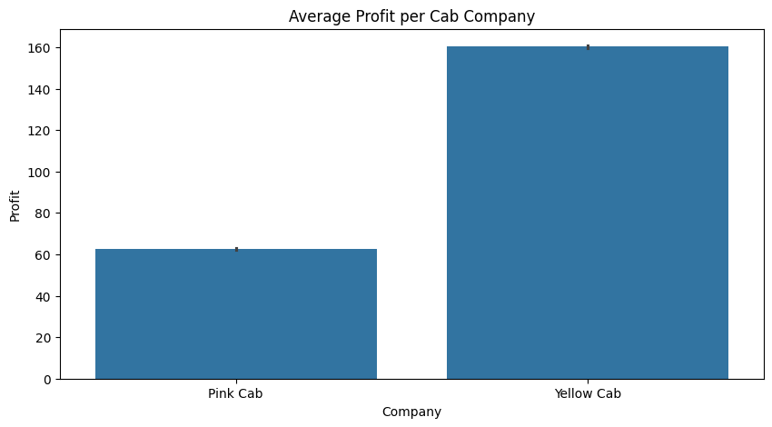
Profit Analysis
Profit Analysis
Distribution of trip cost vs price charged
Yellow Cab has significantly higher average profit than Pink Cab, suggesting better market share, pricing, or efficiency. Further analysis on ride volume, expenses, and pricing strategy could explain this difference.

Slide 11
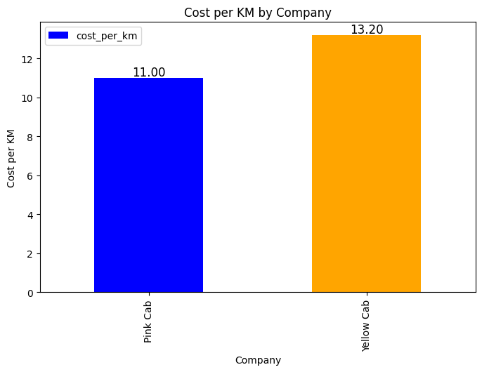
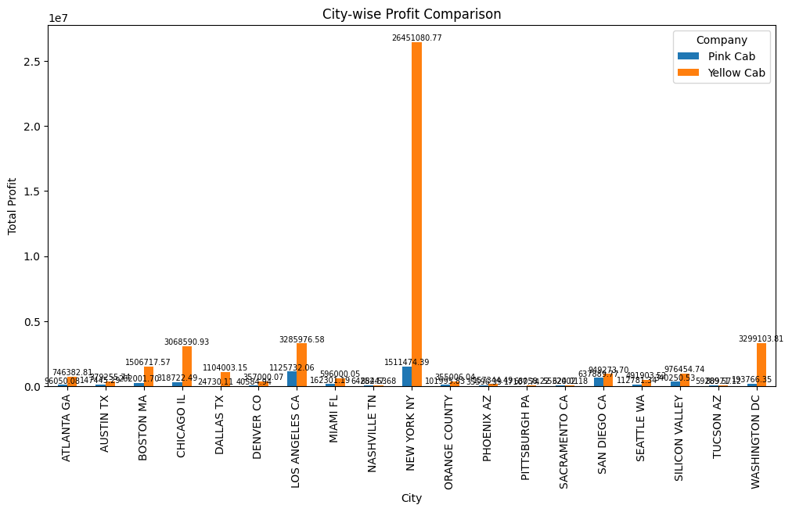
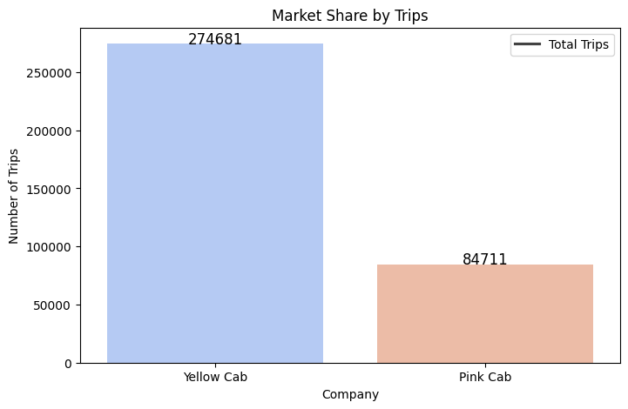
Profit Analysis
Profit Analysis By Company, City and Market Share
→ Yellow Cab has a higher cost per KM (13.2) compared to Pink Cab (11.0), which could indicate premium services or higher operational costs.
→Yellow Cab dominates the market with 274,681 trips, significantly more than Pink Cab's 84,711 trips, giving it a clear edge in customer reach.
→Yellow Cab leads in total profit, with cities like New York contributing the highest (~26M USD).
→Pink Cab has lower profits across cities, indicating less market presence or lower pricing power.

Slide 12
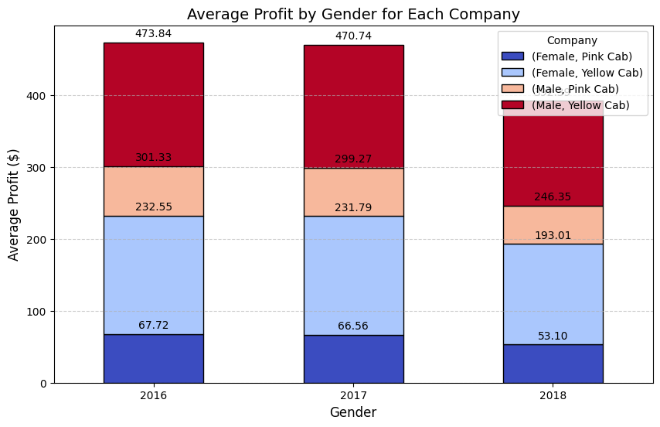
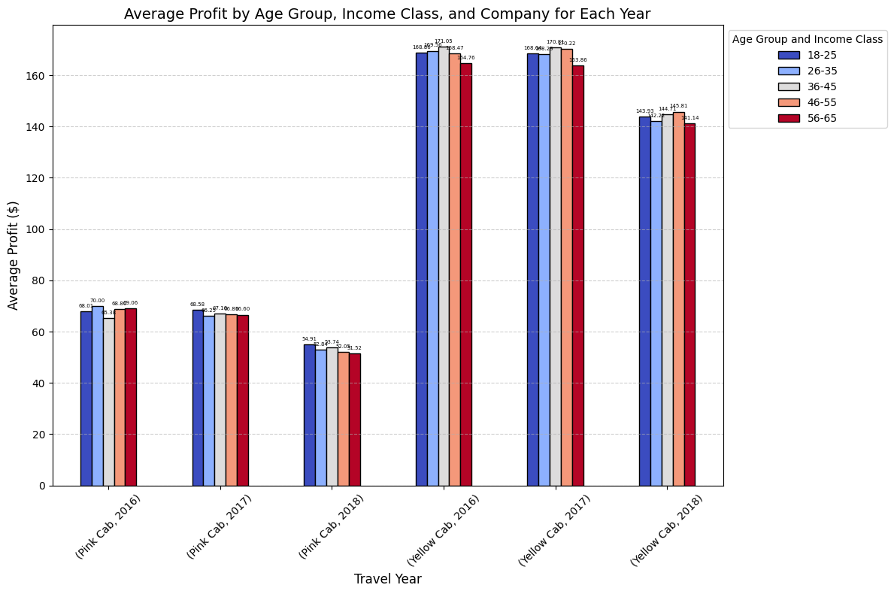
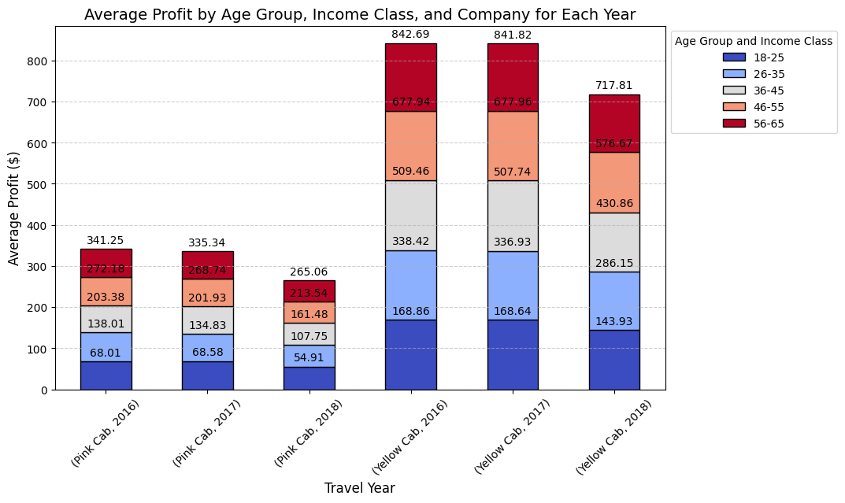
Profit Analysis
Profit Analysis By gender, Age and Income Group
Gender Influence: Males contribute more to profits than females.
Age & Income: Older and wealthier customers generate more profit.
Declining Profits in 2018: Pink Cab sees a decline in 2018 across various segments.
Cab Company Performance: Yellow Cab is more profitable than Pink Cab.

Slide 13
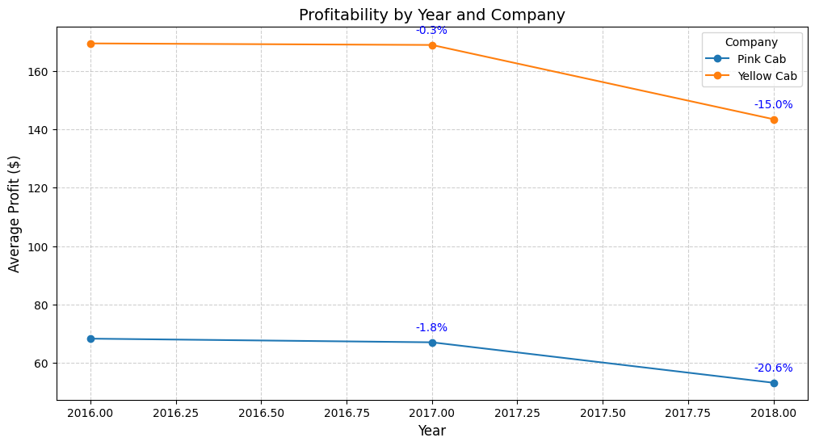
Yearly Profit Analysis

Slide 14
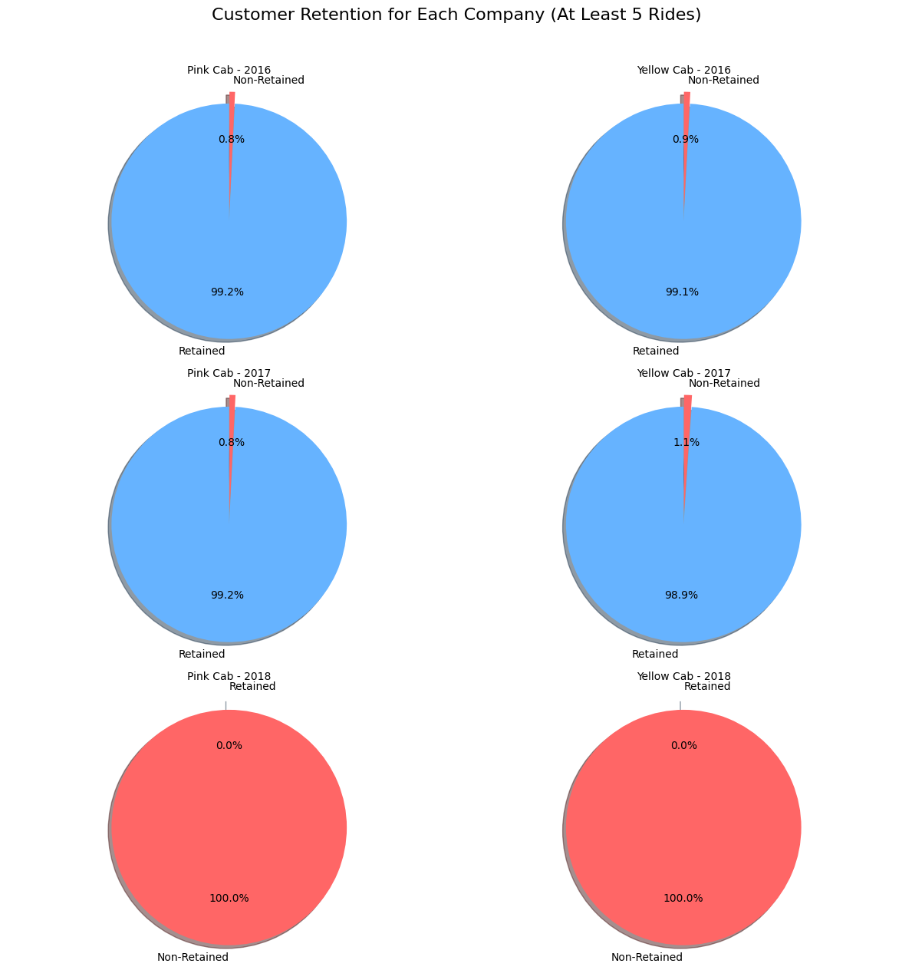
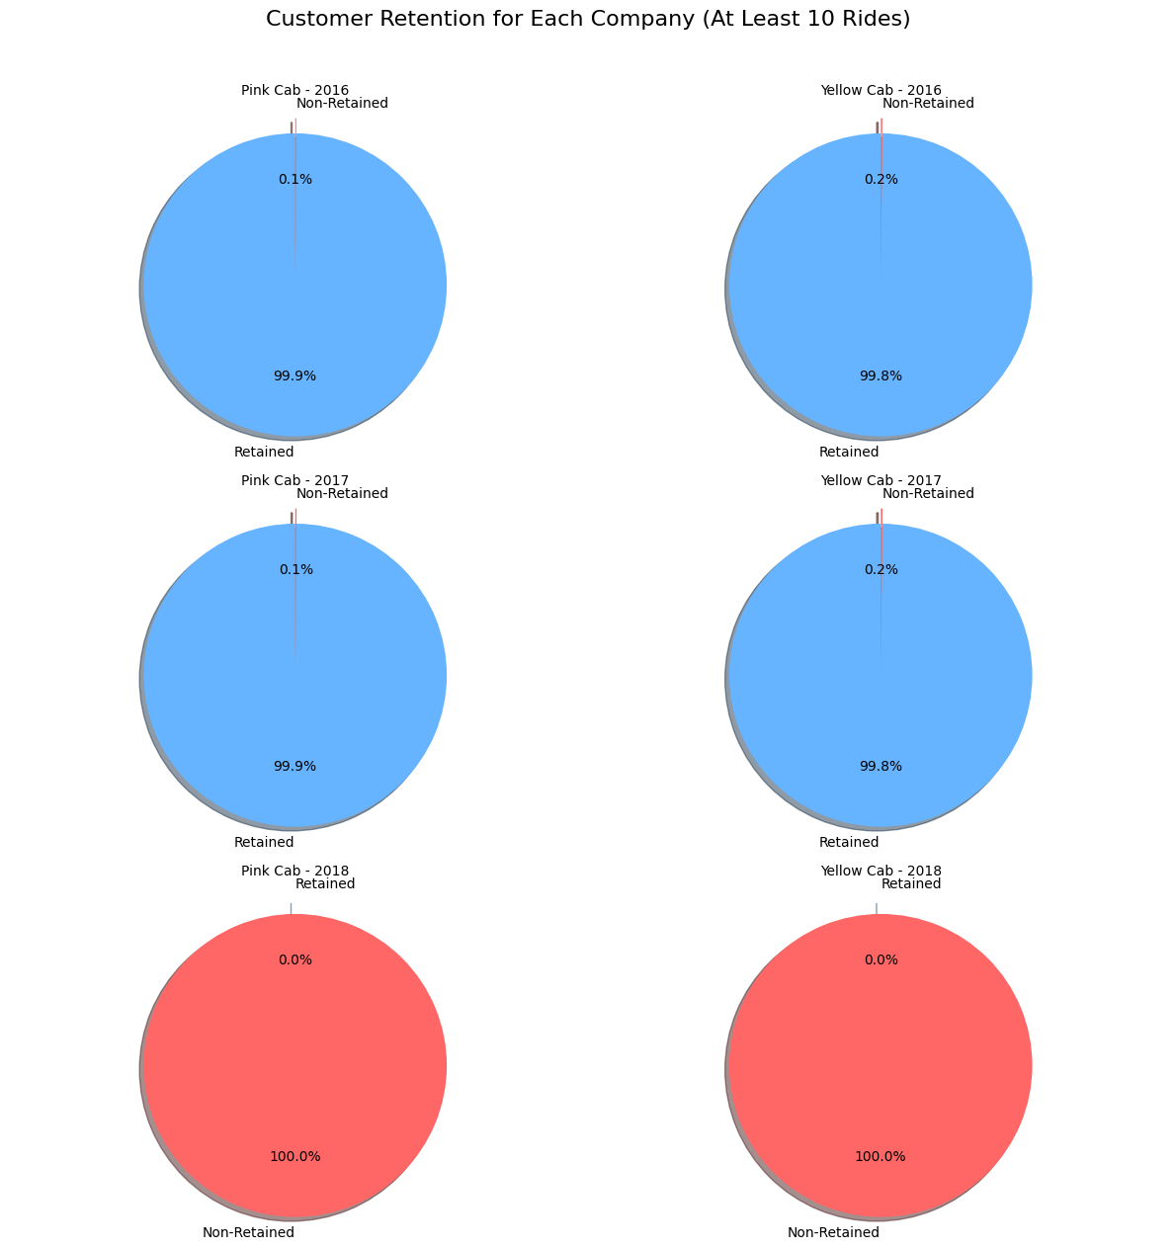
Customer Retention
From 2016 to 2018 they show a decline trends as well.
In the cab services between 2016 and 2017 most of the users retain 5 or 10 cabs. But none of the customers take both services 5 times or more.

Slide 15
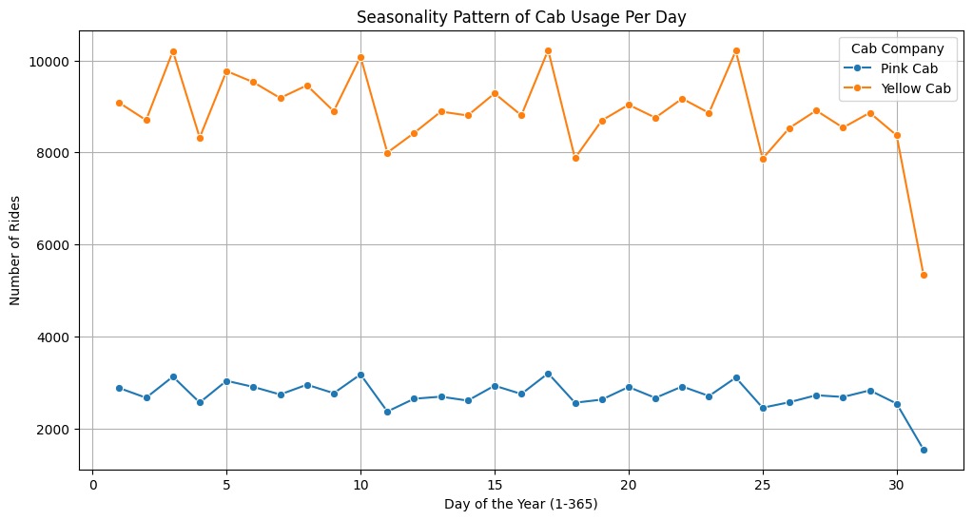
Seasonality in the demand
Seasonal component is present in
both the cabs.
Demand is high on 3rd day of the
month and it repeats similar
pattern every 7 days

Slide 16
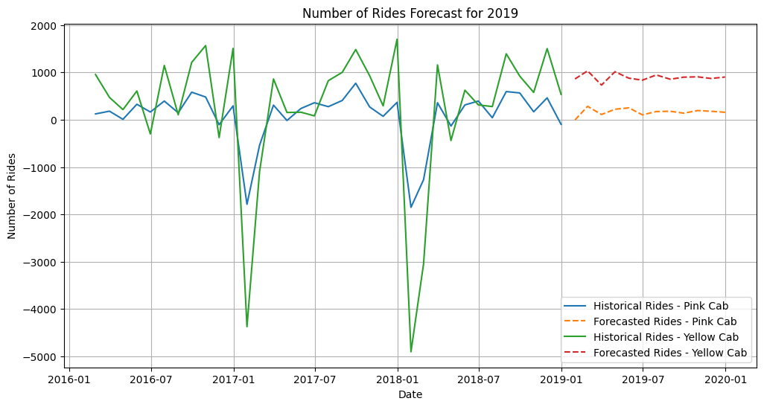
Profit Forecasting for
Seasonal pattern 4 quarter cycle.

Slide 17
Recommendations
We have evaluated both the cab companies on following points and found Yellow cab better than Pink cab:
Higher Profitability – Yellow Cab generates significantly more profit across multiple cities, especially in high-revenue areas like New York.
Market Dominance – It has a much larger customer base with 274,681 trips compared to Pink Cab's 84,711, ensuring steady revenue.
Pricing Power – Despite higher cost per KM (13.2 vs. 11.0), customers still prefer Yellow Cab, indicating strong brand value and demand.
Consistent profit trends, unlike Pink Cab, which saw a decline in 2018.
Higher Profitability: Yellow Cab consistently generates more profit across all years.
Stronger Customer Base: Older and high-income passengers prefer Yellow Cab, ensuring stable revenue.
Steady Performance: Unlike Pink Cab, Yellow Cab maintains strong profits without major decline.
Gender Profit Advantage: Male users, who contribute more revenue, prefer Yellow Cab.

Slide 18
Thank You

